Slide 1
PA State SHRM
2025 Sponsorship & Exhibitor Opportunities

Slide 2
Welcome to PA SHRM
2025
The PA State Council for SHRM is a statewide organization that supports the furthering of the Human Resource profession. The 25 local chapters within Pennsylvania all report to the State Council. The State Council in turn reports to SHRM National.
Pennsylvania SHRM hosts three signature conferences and events throughout the year: the Legal and Legislative Conference, the Volunteer Leadership Conference, and the Annual State Conference.
Our events attract hundreds of professionals from across the state of Pennsylvania and Beyond! Our events are a great opportunity to meet with potential customers, build your organizations brand and network with peers.
We look forward to seeing you at our next event!
2025 Overview
Our Mission-
The Pennsylvania State Council (PA State Council) connects SHRM with local chapters to build awareness, provide professional development, and support SHRM initiatives. By working together, we strive to create a strong, engaged HR community and drive positive outcomes for the HR profession in Pennsylvania."

Slide 3
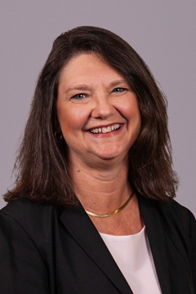
The PA State Council
2025
About us
We provide HR professionals in the Commonwealth of Pennsylvania information on local, statewide and national HR events, resources, initiatives and legislation to assist you in your day-to-day HR duties. For those who serve on local chapter boards, we are also here to assist you in your leadership role. We are a 100% volunteer council that takes a strategic approach to advance the profession and serve the HR professional.
Thank you for being an active member in your SHRM Chapter.
Nancy Foster, SHRM-SCP, SPHR, State Director

Slide 4
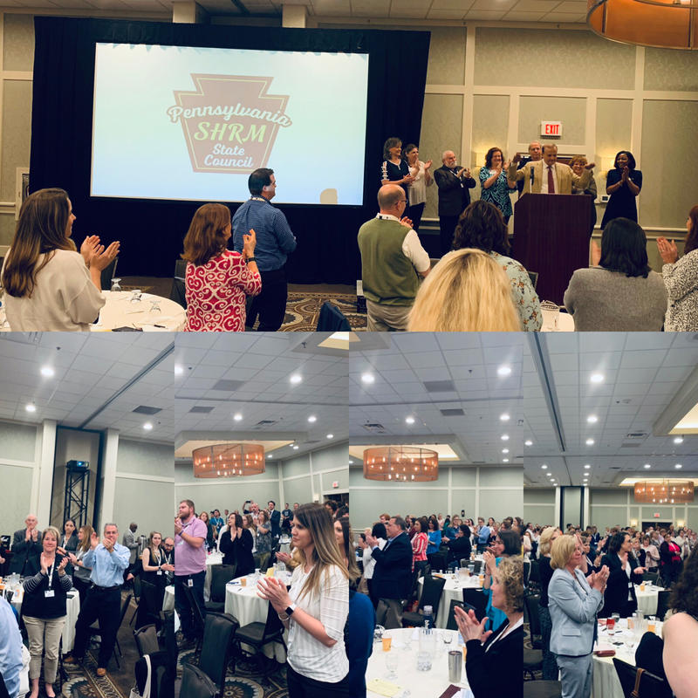
PA State Council for SHRM 2025 Conferences
2025
Legislative & Legal Conference
Volunteer Leadership Conference
Annual State Conference

Slide 5
Sponsor Benefits
2025
Your Target Market
Quality Time
Face Time & Follow-Up
Meet and interact with the exact customers that you are seeking. Our conferences bring together hundreds of HR professionals. In addition to having a strong, on-site presence at the conference, sponsorship of our event allows for the promotion of your company brand throughout the HR community.
Spend more time with our attendees. We go to great lengths to make sure that our exhibitors and sponsors have lots of face time with those who attend our conferences. We encourage this by offering prizes for visiting booths in addition to encouraging our sponsors and exhibitors to raffle items as well.
Stay in front of customers with mentions on PA SHRM official channels. Certain sponsors will have the ability to be shared on our Social Media channels including Twitter, Facebook and LinkedIn. After the conference attendees can also be contacted regarding interaction.*
* Exhibitors have an opportunity to collect contact during each event. Not all exhibit or sponsor opportunity will allow for receipt of attendee list. All Sponsor/Exhibitor packages are subjects to Terms & Conditions, including the E-mail Marketing Policy.

Slide 6
2025 Conference Sponsors
2025
2025 Title Sponsor - $10,000
Various recognition opportunities during all events (3 Conferences)
Logo on PA SHRM website
Branding at Keynote sessions & podium time at all events
Opportunity to introduce the keynote speaker at all events
Sponsor-hosted workshop/breakout
Logo at event tech reception area
#1 Spot in Exhibit Hall
Social Media Shout Outs
Distribution of your promotional literature to conference attendees
4 conference registrations for all events
4 conference registrations to give to VIP’s at each event
Receive an electronic attendee list (post event)
Limit of 1 available
2025 Premier- $5,000
Supports food and break for each conference (3 Conferences)
Introduction of breakout speakers, and/or non keynote sponsor speakers
Logo on PA SHRM websites
Branding in event tech reception
#2 and #3 Spot in Exhibit Hall
Social Media Shout Outs
2 conference registrations for all events
2 complimentary conference registrations for VIPs at event of choice
Receive an electronic attendee list (post event)
Limit of 3 available
Available for a limited time only with a limited number of opportunities!
This is your opportunity to partner with PA SHRM to support 3 world class educational events that contribute to moving the HR profession forward for 2024. Through your support, your organization can receive recognition, and access to robust opportunities to network and speak with our guests.
Legislative & Legal Conference, Friday, April 28th
Leadership Conference, Friday, July 21st
Annual PA State Conference, Thursday, September 14th and Friday, September 15th.

Slide 7
2025 Conference Continued
2025
All Conference Exhibitor- $3,000
All State Conference Session Spotlight (3 Conferences)
Prominent brand exposure
Exhibit booth
Social Media Shout Outs
2 complimentary attendee registrations at each event
1 complimentary registration for a VIP at each event
10 Available Total
Exhibitor Booth- $1,250
Secures an exhibitor table at 1 PA SHRM Conference (L&L, Leadership or Annual)
2 complimentary attendee registrations at event
20 Available Per Conference
Available for a limited time only!

Slide 8
2025 Conference Continued
2025
Breakfast Sponsor- $2000
Signage at the Breakfast Area
Podium Time
Secures an exhibitor table at 1 PA SHRM Conference (L&L, Leadership or Annual)
Social Media Shout Outs
2 complimentary attendee registrations at event
3 Available Per Conference
Lunch Sponsor- $2000
Signage at the Lunch Area
Podium Time
Secures an exhibitor table at 1 PA SHRM Conference (L&L, Leadership or Annual)
Social Media Shout Outs
2 complimentary attendee registrations at event
3 Available Per Conference
Networking/Happy Hour - $3000
PASHRM Sanctioned Happy Hour – Networking Event
We help get attendees there!
Secures an exhibitor table at 1 PA SHRM Conference (L&L, Leadership or Annual)
Additional Signage at the Conference!
Social Media Shout Outs
2 complimentary attendee registrations at event
3 Available Per Conference
Available for a limited time only!

Slide 9
2025 Conference Continued
2025
Lanyard Sponsor - $600
Sponsor Lanyards for our event!
Sponsors logo will be included on Lanyard
Deadline of at least 30 days before selected conference
1 Available Per Conference
Bag Sponsor- $600
Sponsor bags for our event!
Sponsors logo will be included on bag
Deadline of at least 30 days before selected conference
2 Available Per Conference
TECHNOLOGY SPONSORSHIP-$1000
Logo on intro slide deck for all attendees to see
Sponsor Shout Out
Logo on all marketing materials prior to conference
BAG STUFFER - $100
Available for a limited time only!

Slide 10
Exhibitor and Sponsor Experience
2025
What they are saying
A glimpse of our past sponsors
“In our first year of sponsoring we secured $700,000 in new revenue.” – Payroll Company
“We come each year and are always happy to see familiar and new faces.” – Consulting Agency
“I am always impressed with the amount of facetime we get as well as the help we receive from the organizers.” – Voluntary Insurance Carrier
“The ROI is well worth the capital investment each year. We also learn and receive credits since we can attend the sessions!” – University Sponsor

Slide 11
THANK YOU!
2025
PA SHRM State Council

